Slide 1


CLEANMITRA
SMART WASTE MANAGEMENT SYSTEM

Slide 2

TEAM DETAILS
ROLL NO | STUDENT NAMES | TEAM LEAD
2310030232 | UDIT RAJ KUMAR
2310030419 | K. HEMA CHARAN REDDY
2310030441 | M. NIHAR REDDY
2310030444 | K. DHEERAJ

Slide 3
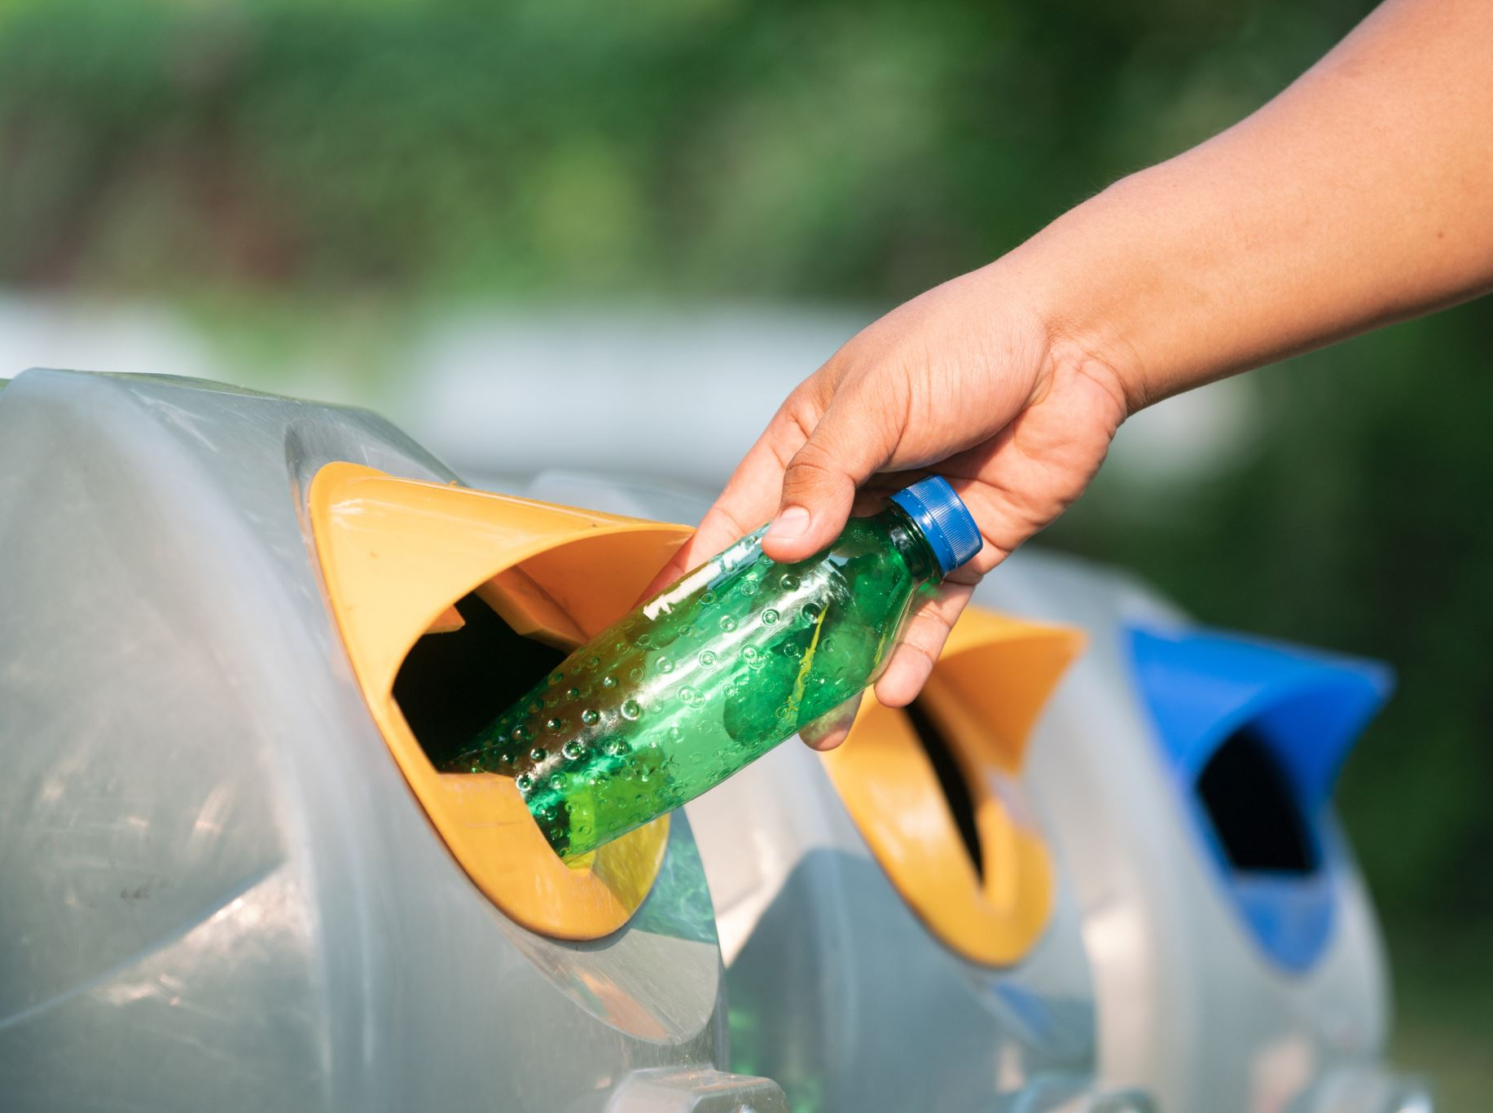
PROBLEM
Urban areas around the world are facing a major crisis in waste management due to rapid urbanization and increasing population density. Traditional waste collection methods are often inefficient and outdated, leading to issues such as uncollected garbage, overflowing bins, delayed responses, and poor sanitation conditions. These inefficiencies contribute to environmental pollution, health risks, and a lack of accountability in municipal operations.
There is a critical need for a smarter, more efficient system that can handle the complexities of modern waste management in real-time. The absence of a centralized platform for issue reporting, status tracking, and data-driven decision-making limits the effectiveness of city sanitation services. Without the use of technology, it's difficult for both residents and authorities to collaboratively manage waste and ensure timely resolutions.

Slide 4
SOLUTION
To address the inefficiencies in traditional waste management, we have developed Clean Mitra – a Smart Waste Management Desktop Application that connects users, administrators, and drivers through a centralized platform. Users can easily report waste-related issues by submitting details and images, which are then received by the administrator. The administrator reviews the reports and assigns them to available drivers based on location and urgency. Drivers receive the task, resolve the issue, and update the system with the resolution status. Built using JavaFX for the user interface and MongoDB with GridFS for backend data and image storage, Clean Mitra ensures real-time tracking, faster response, and improved coordination — all completely free to use, promoting a cleaner and smarter urban environment.

Slide 5
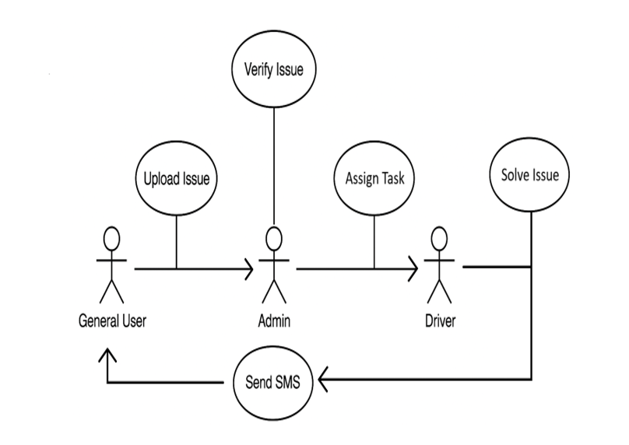
ARCHITECTURE DIAGRAM
User → Administrator The general user reports a waste issue with details and images; the request is sent to the administrator for verification.
Administrator → Driver The administrator reviews the complaint and assigns it to a driver based on location and urgency.
Driver → User The driver resolves the issue, uploads proof of completion, and the system sends an SMS notification to the user confirming the task is completed.

Slide 6
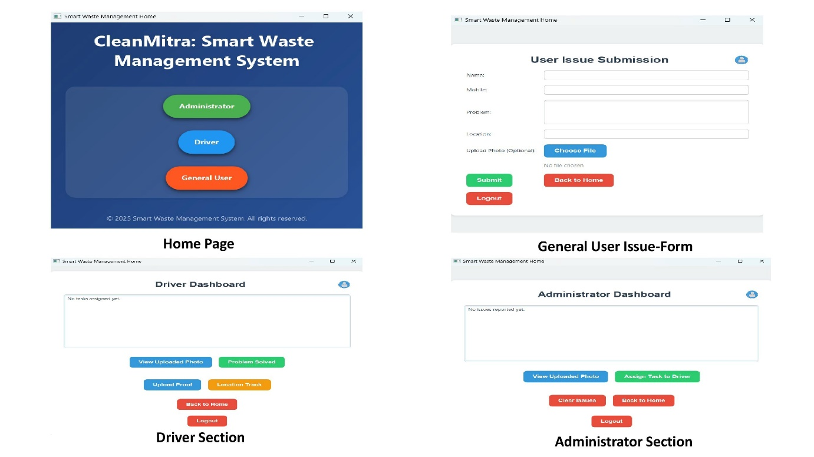
INTERFACE

Slide 7
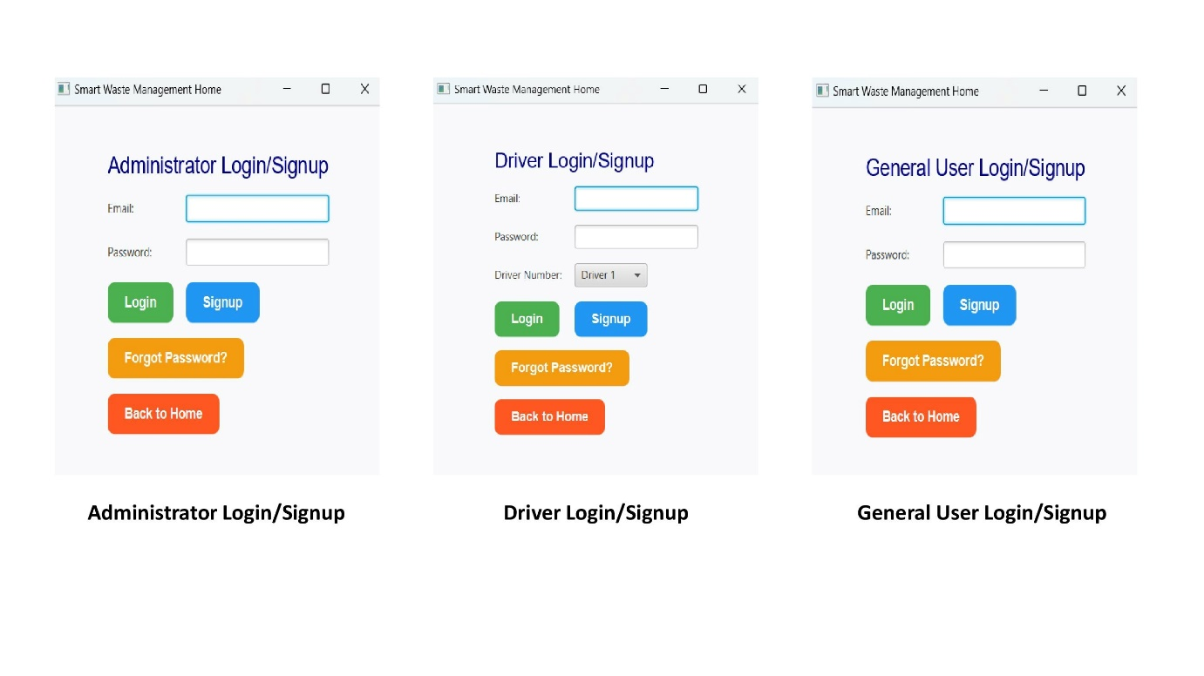
INTERFACE

Slide 8
CONCLUSION
Brings together real-time issue reporting, role-based access, and reliable data handling.
Built with JavaFX and MongoDB for smooth performance and future scalability.
Enables admins to track, assign, and monitor tasks; users to report with photos; and drivers to update instantly.
Supports future features like chatbots, GPS tracking, SMS/email alerts, and mobile app integration.
A smart, modern solution for real-world waste problems—designed for cleaner, smarter cities.

Slide 9



THANK YOU

